Slide 1
Sequence Alignment using Dynamic Programming

Slide 2
Exercise 1:
Align these two different words:
TREE
REED
Method 1:
Align corresponding mismatches and matches
Method 2:
Insert gaps to optimize the alignment
TREE
TREE-
Sequence 1
Sequence 1
REED
-REED
Sequence 2
Sequence 2
3 mismatches
1 match
2 gaps
3 matches
Calculation:
For any two sequences (e.g., TREE & REED) you can calculate the alignment score based on comparison between two corresponding letters of the two words (e.g., a from the 1st sequence and b from the 2nd sequence)
1 (if a=b) a match
A reward
Alignment score in Method 1:
1 + 3 μ
d(a,b)
μ (if a≠b) a mismatch
No reward or A penalty
Alignment score in Method 2:
3 + 2 δ
δ (if a=‘-’ OR b=‘-’) a gap
A penalty
Notes:
Scores are calculated as per the rules of the game.

Slide 3
Problem:
Start from the top left corner, you can move in the right, down, or right-down diagonal until you reach bottom right.
Collect $1 on diagonal moves that result in a match, Collect no money ($0) for diagonal moves that result in a mismatch. Pay $1 penalty on non-diagonal moves (gaps to right or down). Which path will you take to collect the largest amount of money until you reach the bottom right square? Draw a line of your selected path and the total money you collected.
Dynamic Programming Table
TREE
Sequence 1
Sequence 2 distributed as columns
Possible Moves
E
REED
R
E
D
Sequence 2
0
The starting cell is like comparing an empty sequence 1 to an empty sequence 2:
Score rules
T
-1
-
R
Sequence 1
-1
1 if match
0 if mismatch
Sequence 1 distributed as rows
-
Sequence 2
E
Match: +1
Mismatch: 0
Gap: -1
E
Notes:
Some cells have only one way to reach to them. Either left to right or top to down with a penalty.
Other cells have three ways to reach them. You need to calculate the three ways and decide which is the best move to them. Write the score

Slide 4

TREE
Sequence 1
Sequence 2 distributed as columns
REED
E
Sequence 2
R
E
D
When you insert a gap to the right:
You are expanding in sequence 2 without expanding in sequence 1
-1
0
-1
-2
-3
-4
T
Some cells can only be reached by inserting a gap to the right (like the first row cells)
i.e., Only one possible score is calculated and written. Also leave the direction of the Path selected.
This is like comparing an empty sequence 1 to sequence 2:
R
Sequence 1 distributed as rows
E
E
-
Sequence 1
R
Sequence 2
Notes:
Some cells have only one way to reach to them. Either left to right or top to down with a penalty.
Other cells have three ways to reach them. You need to calculate the three ways and decide which is the best move to them. Write the score

Slide 5
TREE
Sequence 1
Sequence 2 distributed as columns
REED
E
Sequence 2
R
E
D
0
-1
-2
-3
-4
When you insert a gap downwards:
You are expanding in sequence 1 without expanding in sequence 2
T
-1
-1
R
Sequence 1 distributed as rows
Some cells can only be reached by inserting a gap downward (like the first column cells)
i.e., Only one possible score is calculated and written.
This is like comparing a part of sequence 1 to an empty sequence 2:
E
E
?
T
Sequence 1
Exercise 2:
Calculate the score and draw the visual alignment between the two sequences when you reach the above square.
-
Sequence 2

Slide 6
TREE
Sequence 1
Sequence 2 distributed as columns
REED
E
Sequence 2
R
E
D
0
-1
-2
-3
-4
T
-1
R
-2
Sequence 1 distributed as rows
E
-3
E
-4
TREE
Answer:
Sequence 1
Sequence 2

Slide 7
TREE
Sequence 1
Sequence 2 distributed as columns
REED
E
Sequence 2
R
E
D
0
-1
-2
-3
-4
When you move diagonally:
You are aligning and comparing two letters together from sequence 1 and sequence 2. The result is either:
Matching: (give a reward)
Mismatching: (give no reward or a penalty)
T
0
-1
-1
0
-1
R
-2
Sequence 1 distributed as rows
Many cells can be reached by three ways:
1-inserting a gap to the right (with a penalty)
2-inserting a gap downward (with a penalty)
3-move diagonally (either match or mismatch)
i.e., Calculate the 3 possible scores and choose the best one(s) among them. (two options can be best and equal. Both will be kept)
Here, the best move is to choose 0 and record the selected path.
E
-3
E
-4
This is a direct alignment between two letters:
T
Sequence 1
R
Sequence 2

Slide 8
TREE
Sequence 1
Sequence 2 distributed as columns
REED
E
Sequence 2
R
E
D
Exercise 3:
Calculate the score and draw the visual alignment between the two sequences when you reach the above square.
0
-1
-2
-3
-4
T
-1
-1
0
-1
-1
R
-2
Sequence 1 distributed as rows
E
-3
E
-4
Answer:
T-
Sequence 1
RE
Sequence 2

Slide 9
TREE
Sequence 1
Sequence 2 distributed as columns
REED
E
Sequence 2
R
E
D
0
-1
-2
-3
-4
Exercise 4:
Calculate the score in the cell with question mark.
T
-1
0
-1
R
-2
?
Sequence 1 distributed as rows
Philosophy of thinking:
From this cell, go back to get the values from the three direct neighbors. If a neighbor is not yet calculated, go back its three neighbors, and so on.
E
-3
E
-4
Dynamic Programming:
Depends on storing the values of solutions of previous smaller problems then reusing them when solving the bigger problem.

Slide 10
TREE
Sequence 1
Sequence 2 distributed as columns
REED
E
Sequence 2
R
E
D
Exercise 3:
Calculate the score and draw the visual alignment between the two sequences when you reach the above square.
0
-1
-2
-3
-4
T
0
-1
-2
-3
-1
0
-1
-1
-2
-2
-3
-3
R
0
0
-1
-2
-2
0
0
-1
-1
-2
-2
Sequence 1 distributed as rows
-1
1
1
Many cells can be reached by three ways:
1-inserting a gap to the right (with a penalty)
2-inserting a gap downward (with a penalty)
3-move diagonally (either match or mismatch)
i.e., Calculate the 3 possible scores and choose the best one(s) among them. (two options can be best and equal. Both will be kept)
Here, the best move is to choose 0 and record the selected path.
E
-3
-1
1
1
0
0
-1
0
0
2
1
E
-4
-2
0
2
1
1
Answer:
TREE-
Sequence 1
-REED
Sequence 2

Slide 11


TREE
Sequence 1
Sequence 2 distributed as columns
REED
E
Sequence 2
R
E
D
Exercise 3:
Calculate the score and draw the visual alignment between the two sequences when you reach the above square.
0
-1
-2
-3
-4
T
0
-1
-2
-3
-1
0
-1
-1
-2
-2
-3
-3
R
0
0
-1
-2
-2
0
0
-1
-1
-2
-2
Sequence 1 distributed as rows
-1
1
1
Start from the last cell and think of the direct neighbors.
E
-3
-1
1
1
0
0
-1
0
0
2
1
E
-4
-2
0
2
1
1
Path1:
TREE
Sequence 1
REED
Sequence 2

Slide 12




TREE
Sequence 1
Sequence 2 distributed as columns
REED
E
Sequence 2
R
E
D
0
-1
-2
-3
-4
T
0
-1
-2
-3
-1
0
-1
-1
-2
-2
-3
-3
R
0
0
-1
-2
-2
0
0
-1
-1
-2
-2
Sequence 1 distributed as rows
-1
1
1
You will have the highest possible score 2, if you are aligning:
E
-3
-1
1
1
0
0
-1
0
0
2
1
TREE
E
-4
-2
0
2
1
1
Sequence 1
-REE
Sequence 2
Path2:
TREE-
Since you are aligning the two full sequences till the end, both path1 and path2 in this case give the same final score (1)
Sequence 1
-REED
Sequence 2
Notes:
As we saw here, to reach the same final max score (1), we had two different paths in this problem. It could be more or less paths that leads to same final alignment score in other problems.

Slide 13
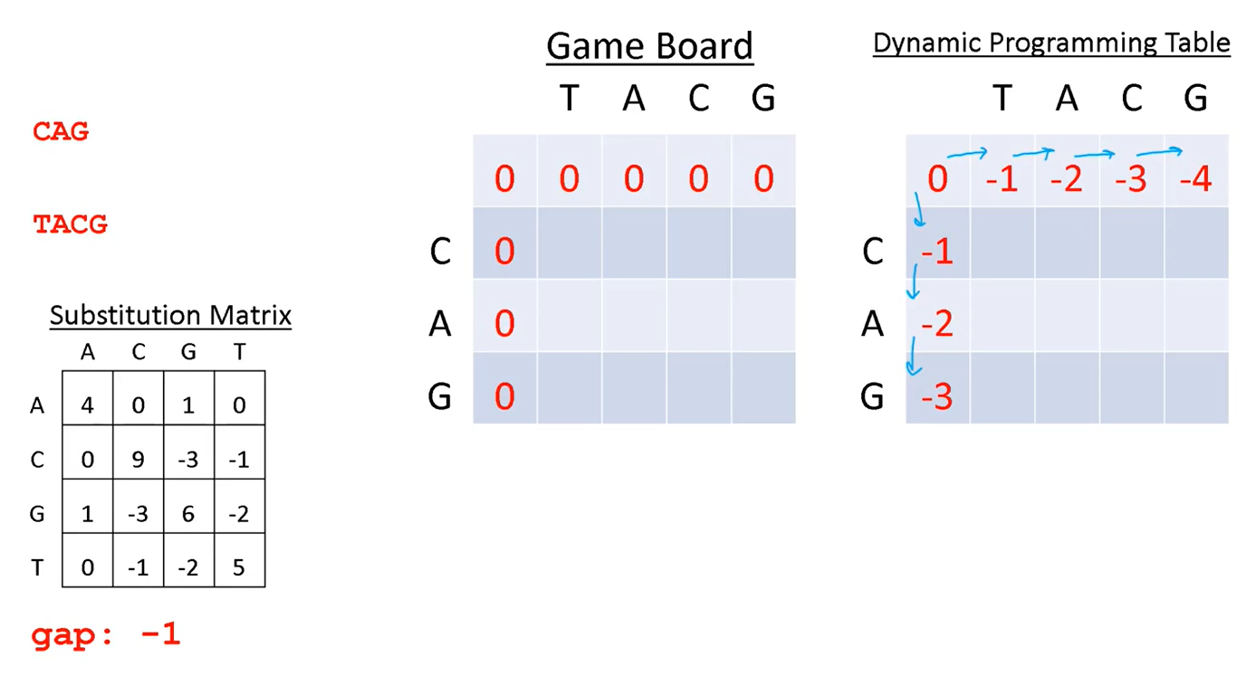
Notes:
In some problems, values of match and mismatch can be provided through a table called substitution matrix.

Slide 14
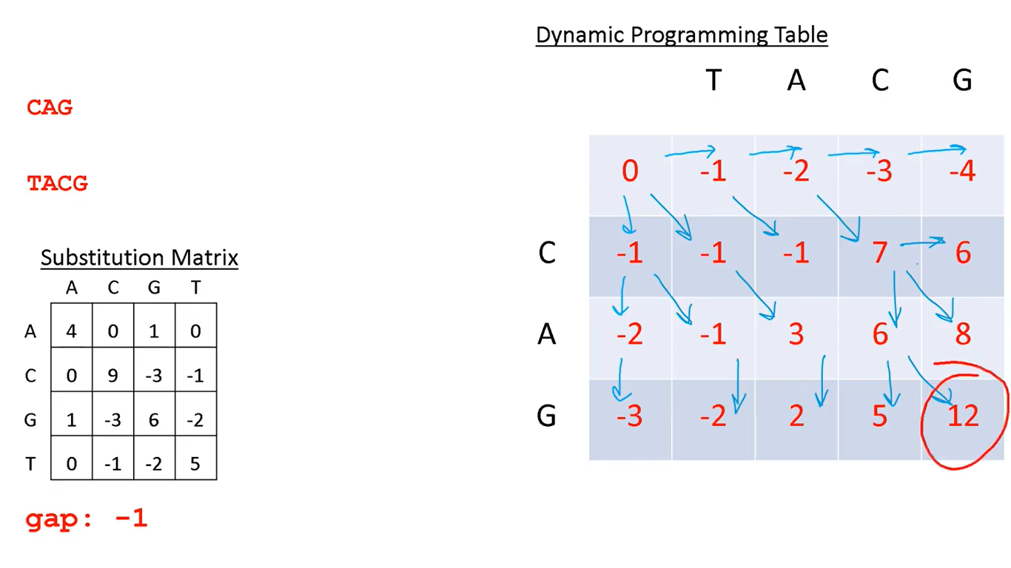

Slide 15
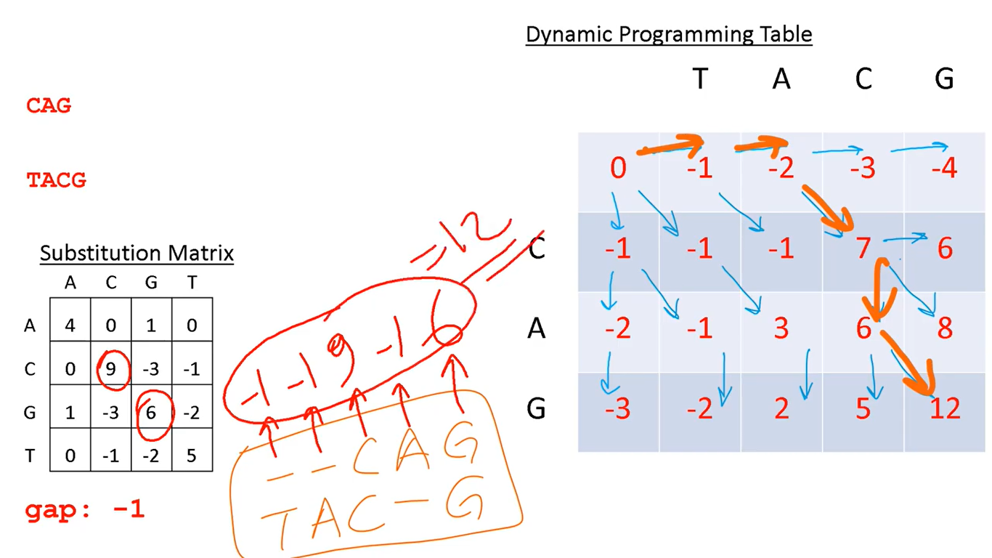
Notes:
From the last cell, go back to track the path(s) that led to it.

Slide 16
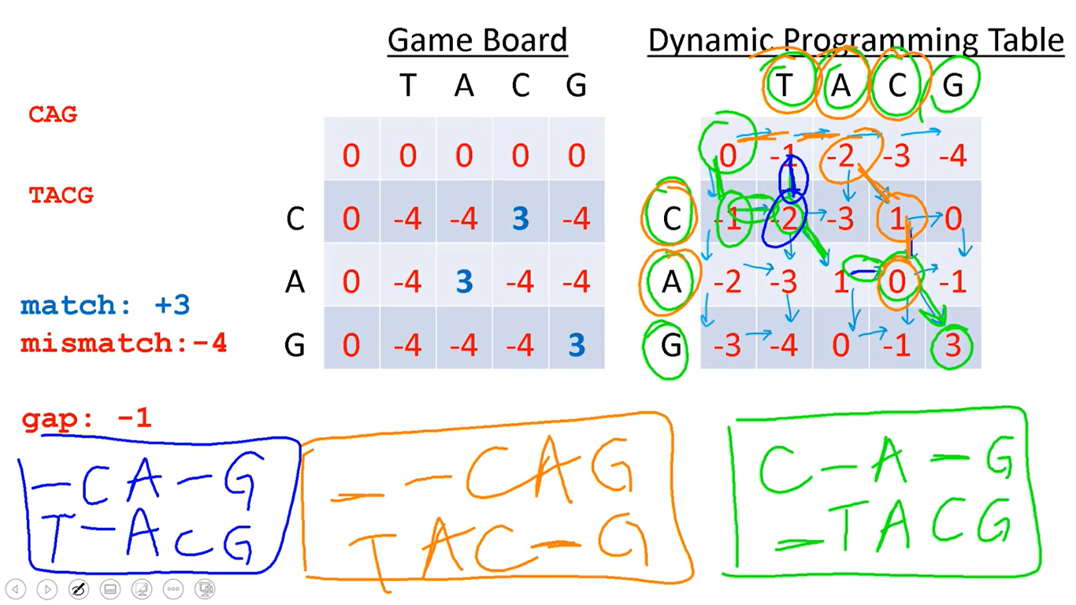
The three possible alignments that add up to a score of 3
Notes:
A example of a problem with three possible path options that lead to the same maximum score of 3 at the end.

